Slide 1
Vision & AI base
Self-driving Model Car

Slide 2
Project Overview
- Summary, Block Diagram
Roles & Responsibilities
- Role of Mine
Specification
- ROS Publisher(keyboard, cam)
- ROS Subscriber(car_control)
- car_control(stm32, usart, Test QT)
Result

Slide 3
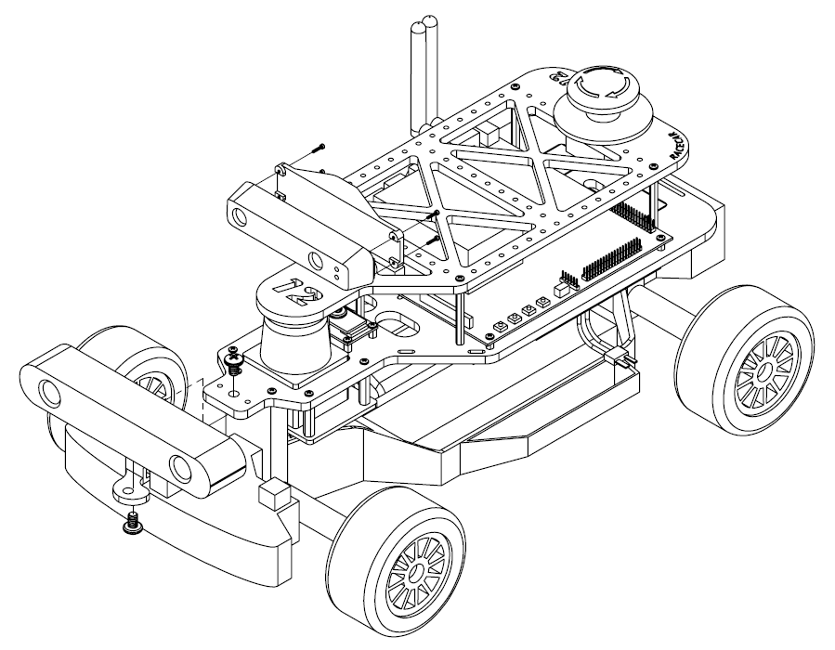
Project Overview SUMMARY
Vision & AI Base Self-driving Model Car
Project Goals 1. Self-driving in Self-produced track(Straight and S Course) 2. Stop at the stop line and Bypass the hurdle Using Image Processing(OpenCV) 3. Recognition of traffic light and sign Using A.I(Machine Learning)
Application
Image Processing Machine Learning
NVIDIA JETSON TX2
ROS
Middle Ware
360 Laser Distance Sensor LDS-01
Linux
STM32 F722ZE
Motor Motor ESC
ARM Cortex A57 CPU
Logitech Camera

Slide 4
Project Overview HARDWARE DIAGRAM
Vision & AI Base Self-driving Model Car
→ Electric Current
TX2 Battery
NVIDIA JETSON XAVIER
Logi Camera
NVIDIA JETSON TX2
LDS Sensor
USB HERB
Logi Camera
STM32 F722ZE
Brushless Motor
Car Battery
ESC
Steering Servo

Slide 5
Project Overview HARDWARE DIAGRAM
Vision & AI Base Self-driving Model Car
→ Data
Logi Camera
NVIDIA JETSON XAVIER
Logi Camera
LDS Sensor
USB
NVIDIA JETSON TX2
IMU Sensor
HERB
STM32 F722ZE
ESC
Brushless Motor
Steering Servo

Slide 6
Role
Car(Motor, ECS) Control TX2 ↔ STM32 Communication ROS Publisher(Keyboard Joystick, Image Processing), Subscriber(Application)
Roles & Responsibilities
Vision & AI Base Self-driving Model Car
Lee Jun Tae
Jang In Sang
Role Sensor(LDS) Data Analysis
Bluetooth Module
ROS Publisher(LDS)
Lee Mi Reu
Jung Ji Won
Role(Software)
Machine Learning(A.I) ROS Publisher(A.I) And Analysis
Role(Software)
Image Processing(OpenCV) Lane, Stop Line detection
And Analysis

Slide 7
Specification Robot OS
Vision & AI Base Self-driving Model Car
Node/Topic/MSG
Publisher
Subscriber
Node ‘KEYBOARD’
Topic Name ‘keyboard’
MSG: flaot32[] keyboard
[start(1)/stop(0), steer, speed, speed_before]
Node ‘car_control’
Topic Name ‘keyboard’ ‘ai’ ‘lds’ ‘cam’
MSG ‘four_floats’
floatt32[] keyboard
int8 ai
float32[3] lds
float32[] cam
Node ‘LDS’
Topic Name ‘lds’
MSG: float32[3] lds
[detection(0)/None(1), angle, distance]
Node ‘CAM’
Topic Name ‘cam’
MSG: float32[] cam
[steer, speed, speed_before]
Node ‘AI’
Topic Name ‘ai’
MSG: int8 ai
detection(1)/None(0)

Slide 8
Specification Robot OS
Vision & AI Base Self-driving Model Car
Communication Config.
TX2 Master URI
roscore
192.168.105.4:11311
TX2 Publisher Node
IP : 192.168.105.4
‘KEYBOARD’ ‘LDS’ ‘CAM’
TX2 Subscriber Node
IP : 192.168.105.4
‘car_control’
XAVIER Publisher Node
IP : 192.168.105.5
‘AI’

Slide 9
Specification Robot OS
Vision & AI Base Self-driving Model Car
Subscriber ‘car_control’
keyboard[0]=1
Yes
Keyboard joystick control
Serial write
No
ai or lds[0]=1
Yes
car_control speed=0
No
cam control

Slide 10
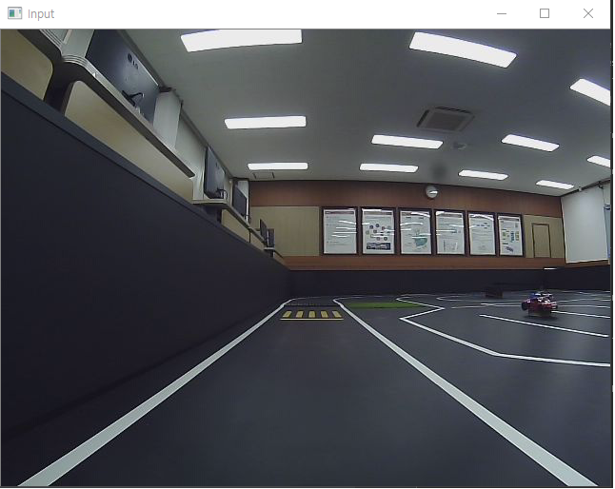
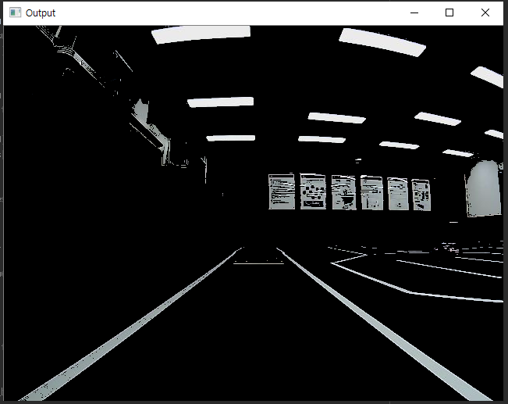
Specification Robot OS
Vision & AI Base Self-driving Model Car
Publisher ‘CAM’
Original
Split White, Yellow Color

Slide 11
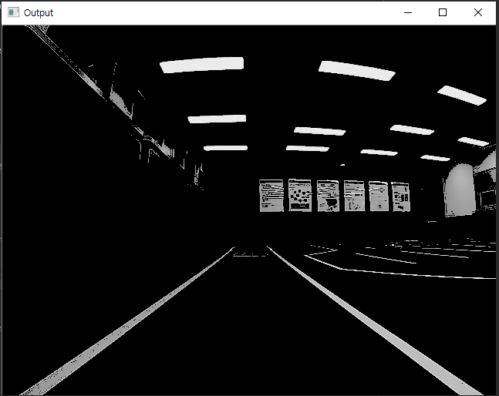
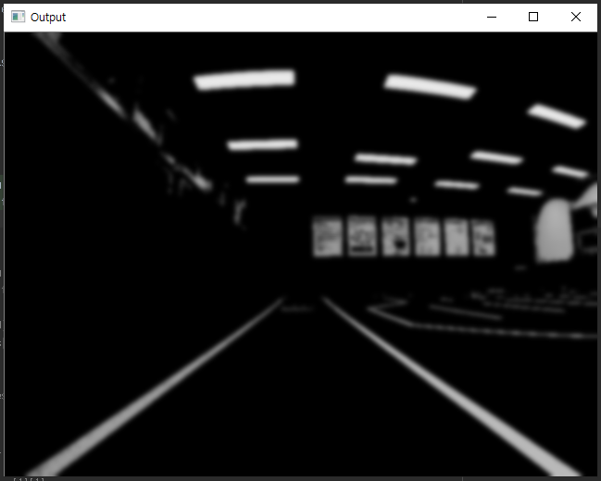
Specification Robot OS
Vision & AI Base Self-driving Model Car
Publisher ‘CAM’
Gray scale
Smoothing

Slide 12
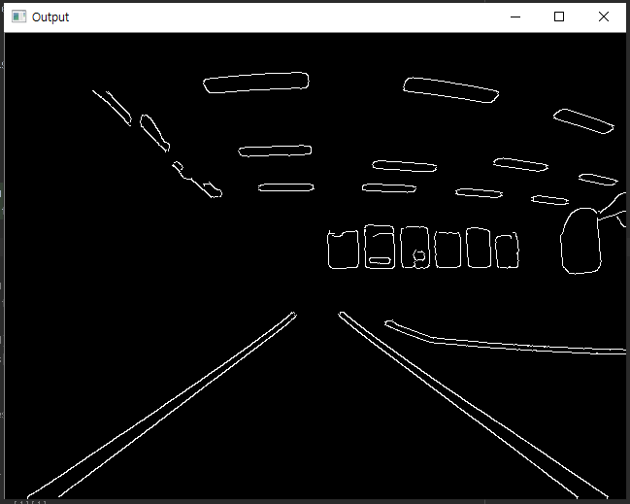
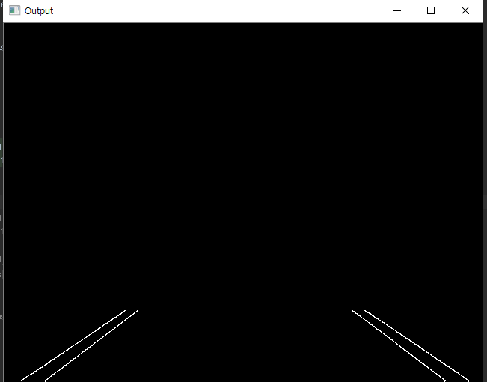
Specification Robot OS
Vision & AI Base Self-driving Model Car
Publisher ‘CAM’
Canny edge
ROI

Slide 13
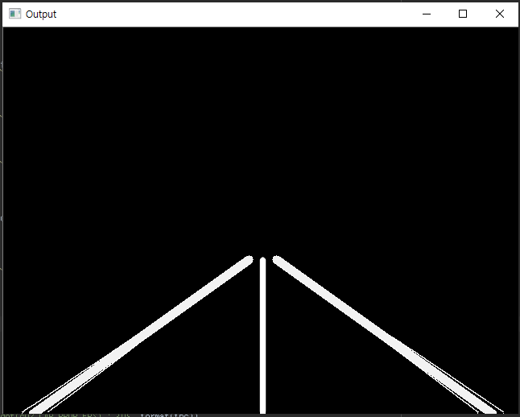
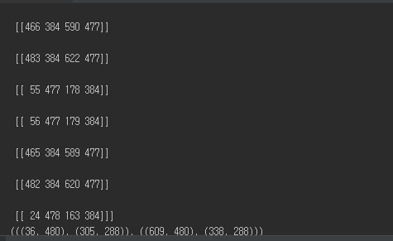
Specification Robot OS
Vision & AI Base Self-driving Model Car
Publisher ‘CAM’
Houg Transform Avg.
Draw Line(Lert, Right, Middle)

Slide 14
Specification Robot OS
Vision & AI Base Self-driving Model Car
Publisher ‘CAM’
Detect left, right line full
Middle Line Slope = (x1-x2)/(y2-y1)
Radian = atan(Middle Line Slope)
Degree = (180 / Pi) * Radian
Steer = Degree * 0.35
Speed = 1
Detect only one line
Detect Left line
Steer = 5, Speed = 1
Detect Right line
Steer = -5, Speed = 1
No Detect line
Steer = 0
Speed = 0
x
-
+
y
Pt1(x1, y1)
Pt2(x2, y2)

Slide 15
Specification Robot OS
Vision & AI Base Self-driving Model Car
Publisher ‘KEYBOARD’
Use python pygame
msg.keyboard = [start(1)/stop(0), steer, speed, speed_before]
Press ‘s’key → msg.keyboard[0] = 1 → car_control node keyboard control
Press ‘q’key → msg.keyboard[1] = 0 → car_control node cam control
Press ‘↑’key → speed = speed + 1 (-1 ~ 3)
Press ‘↓’key → speed = speed - 1 (-1 ~ 3)
Press ‘→’key → steer = steer +1 (-15 ~ 15)
Press ‘←’key → steer = steer – 1 (-15 ~ 15)
-
+
y

Slide 16
Specification Car Control
Vision & AI Base Self-driving Model Car
Block Diagram
Servo
Motor
PWM(TIM1-Channel1)
NVIDIA JetsonTX2
USART ttyACM0
STM32 F722ZE
Nucleo
PWM Generation
3.3V
UART3 Receive
USART ttyACM0
UART3 Transmit
PWM(TIM1-Channel2)
7.4V 6200mAh Battery
ESC
Brushless
Motor
7.4 V

Slide 17
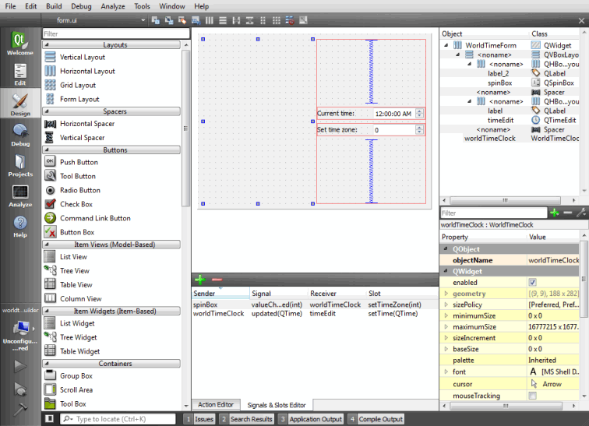
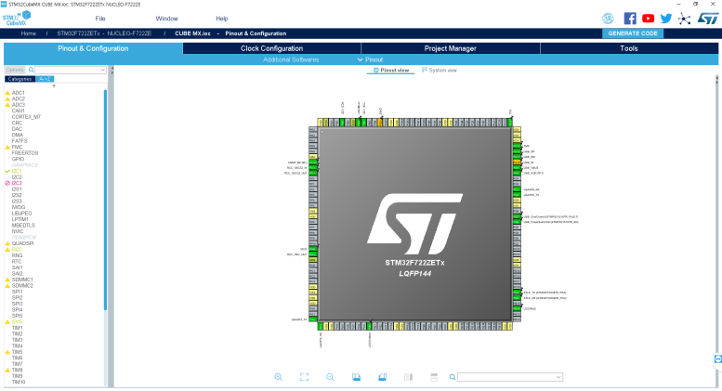
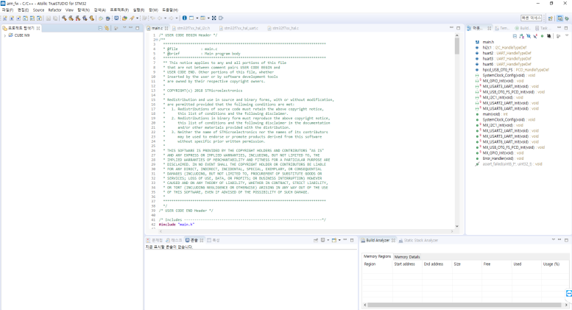
Specification Car Control
Vision & AI Base Self-driving Model Car
Software Tools
QT Creator – GUI Generation Purpose on NVIDIA Jetson TX2 Development Kit
STM32 CUBE MX – A graphical software configuration tool that allows the generation of C initialization code using graphical wizards
Atollic TrueSTUDIO for STM32 – Extensive STM32 device and board support Video tutorials, documentation and discussion forums available

Slide 18
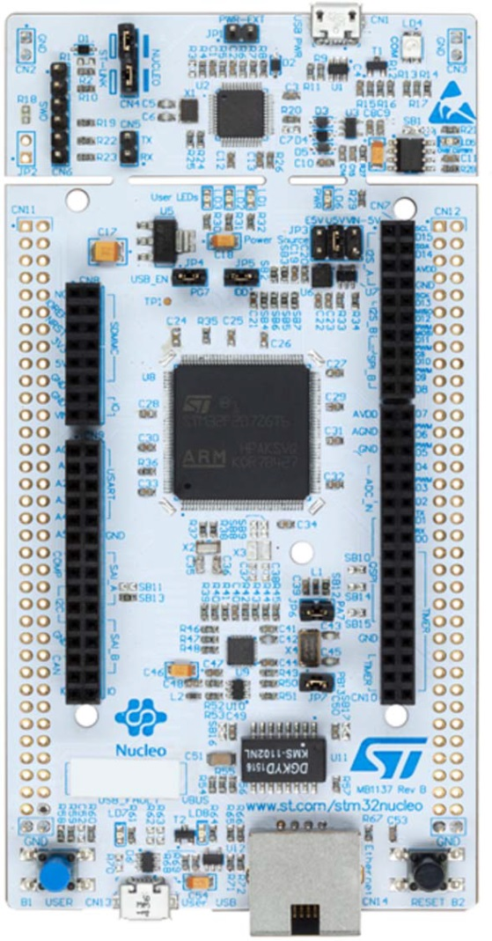
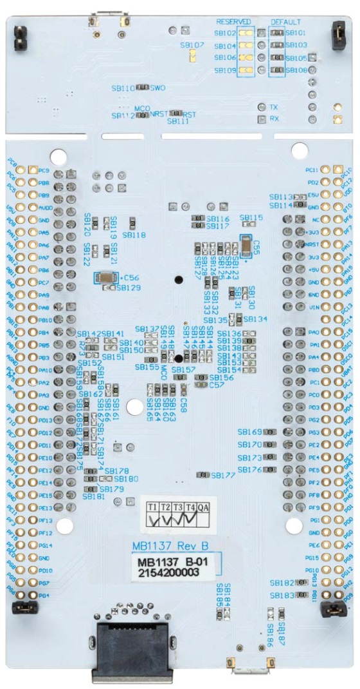
Specification Car Control
Vision & AI Base Self-driving Model Car
STM32 F722ZE Board Specification
CPU : Arm Cortex-M7 core
STM32 microcontroller in LQFP144 package
Ethernet compliant with IEEE-802.3-2002
USB OTG or full-speed device
3 user LEDs
2 push-buttons: USER and RESET
LSE crystal : 32.768 kHz crystal oscillator HSE crystal : 8MHz crystal oscillator
Board connectors : - USB with Micro-AB - Ethernet RJ45

Slide 19
Specification Car Control
Vision & AI Base Self-driving Model Car
CUBE MX PWM Configuration
Sysclk : 216MHz
PWM pulse period : 20ms(f=50Hz)
Prescaler : 1/432
Counter period : 1/10000
1count period : 20ms/10000=0.002ms
Pulse width count = pulse width / 1count period ex) Servo middle = 760 Stepper neutral = 750
Servo(Steering) Motor
Pulse period : 20ms(f=50Hz)
Max left pulse width : 1.08ms
Max right pulse width : 1.96ms
Middle pulse width : 1.52ms
Brushless(Speed) Motor
Pulse period : 20ms(f=50Hz)
Full reverse : 1ms
Neutral : 1.5ms
Full forward : 2ms

Slide 20
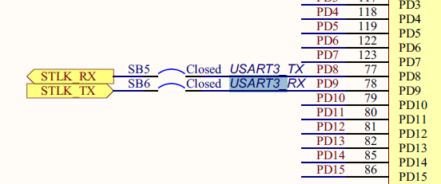
Specification Car Control
Vision & AI Base Self-driving Model Car
USART Communication
Available on PD8 and PD9 - PD8 : USART3 TX, SB5 ON and SB7 OFF - PD9 : USART3 RX, SB6 ON and SB4 OFF
Can be connected either to ST-LINK or to ST morpho connector.

Slide 21

Specification Car Control
Vision & AI Base Self-driving Model Car
Steering
Protocol
760
16 0 도
540
L15(15)
-30도
R/L
980
R15(31)
Steering Left/Right bit
L : 0, R : 1
Steering bit
0(0000)~15(1111) stage
Speed
Neutral : 0
Forward : 1~3 Stage
Reverse : only 1 stage
Speed bit
0(000) : neutral
1(001)~3(011) : 1~3 stage forward
4(100) : only 1 stage reverse

Slide 22
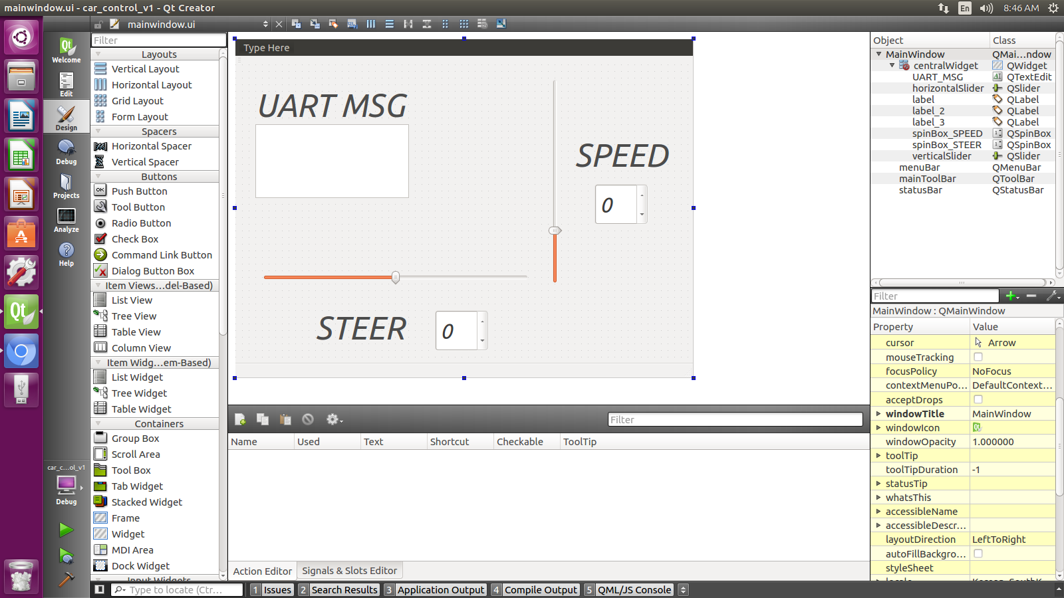
Specification Car Control
Vision & AI Base Self-driving Model Car
NVIDIA Jetson TX2 TestGUI
UART MSG(Text edit)
Transmitted message with UART
Protocol applied
SPEED(Spin box)
Range : Max 3 ~ Min -1
Combined with Vertical bar
STEER(Spin box)
Range : Max 15 ~ Min -15
Combined with Horizontal bar

Slide 23
Result Self Driving Model Car
Vision & AI Base Self-driving Model Car
Project Goals
Self-driving in Self-produced track (Straight and S Course)
Stop at the stop line and Bypass the hurdle Using Image Processing(OpenCV)
Recognition of traffic light and sign Using A.I(Machine Learning)
Project Perfection
Complete
Can’t Bypass the hurdle
Change Object traffic light and sign->cat doll

